Slide 1

Department of Computer Sciences and Engineering
Project-I (CE502)
LikhAI : Handwritten Text Recognition & Processing Application
Presented By
Vivek Tiwari (12331)
Ram Navlani (12300)
Guided By
Dr. Maitri Patel
(Assistant Professor, DCSE)

Slide 2
Outline
Introduction
Literature Review
Modules and Functionalities
Tools & Technology
Implementation
Features
Data Dictionary
Implementation Snapshots (Results)
References

Slide 3
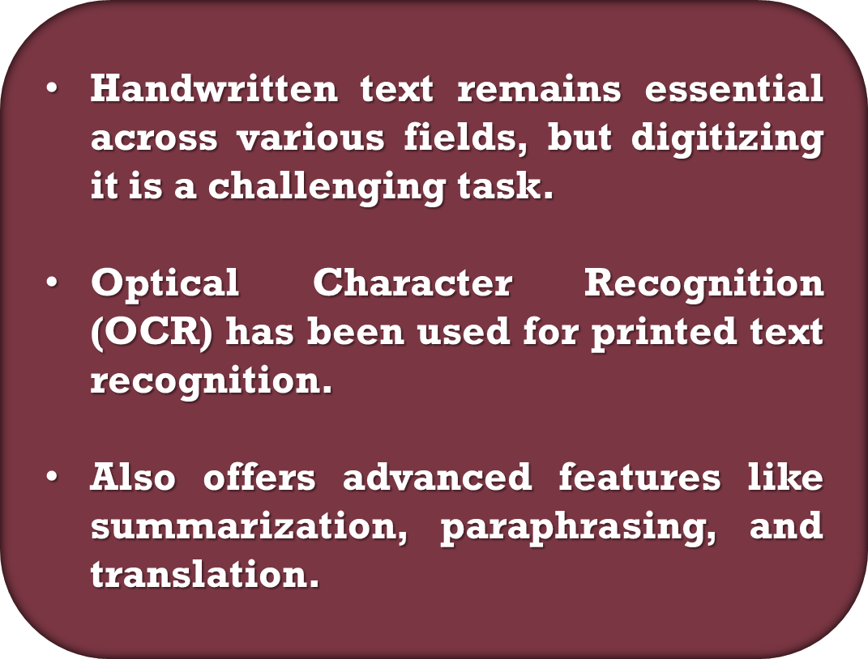
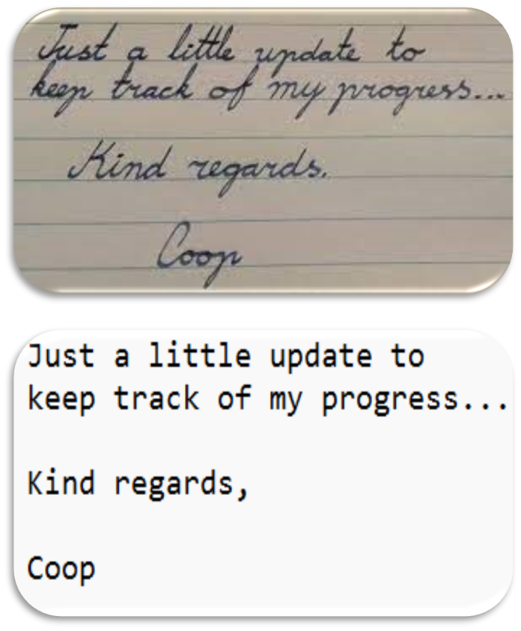
Introduction

Slide 4
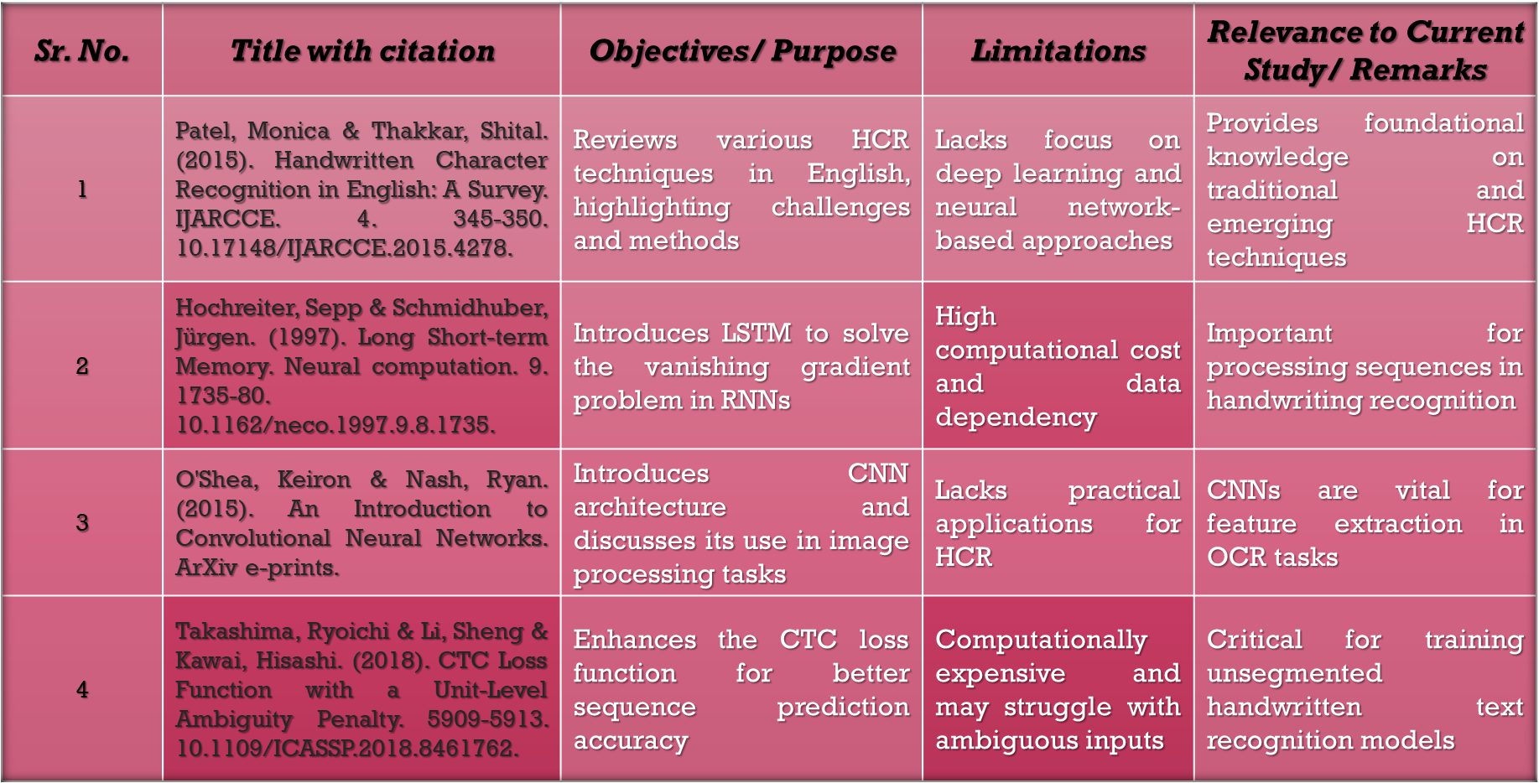
Literature review

Slide 5
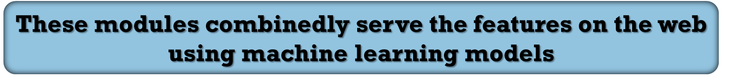
Modules & functionalities
Front – End modules:
index.html
Handles user interface, styling and camera permissions and other web actions using Javascript
Back-end module:
app.py
Contains flask code that handles python modules containing transformer code.
Python Modules:
OCR module, Summarizer module, Paraphraser module, Translator module
Contain functions for the respective feature called by the backend server on frontend.

Slide 6
Tools & technologies
App Development
Front-end : HTML, CSS & Javascript
Model Development
A CNN-LSTM hybrid model is developed using TensorFlow.
Data Collection
The IAM Handwriting, MNIST Dataset is used to train the OCR model
Back-end : Flask
Features: Hugging Face Transformers, Pytorch models
Tesseract OCR engine and pytesseract module

Slide 7
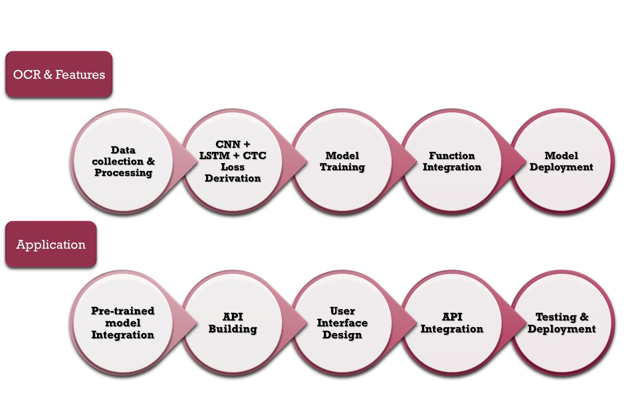
implementation

Slide 8
features
OCR Model:
Using opencv, pillow libraries for image pre-processing and Tesseract OCR engine & pytesseract module are used for ocr text extraction.
Text Summarization and Paraphrasing:
Summarizer transformer "google/pegasus-xsum" & Paraphraser transformer "tuner007/pegasus_paraphrase" is used.
Translation:
Hugging Face Transformer models developed by Helsinki Opus are used for 5 language translations.

Slide 9
Data Dictionary
Field Name | Data Type | Description
User ID | Integer | Unique identifier for each user
Document ID | String | Unique identifier for the uploaded document
Image ID | String | Unique identifier for the preprocessed image
Text | String | Extracted text from the OCR process
Processing Type | String | Type of text processing selected (Translation, Summarization, paraphraser etc.)
Result ID | String | Unique identifier for the processed result
Processing Date | DateTime | Date and time when the text was processed

Slide 10
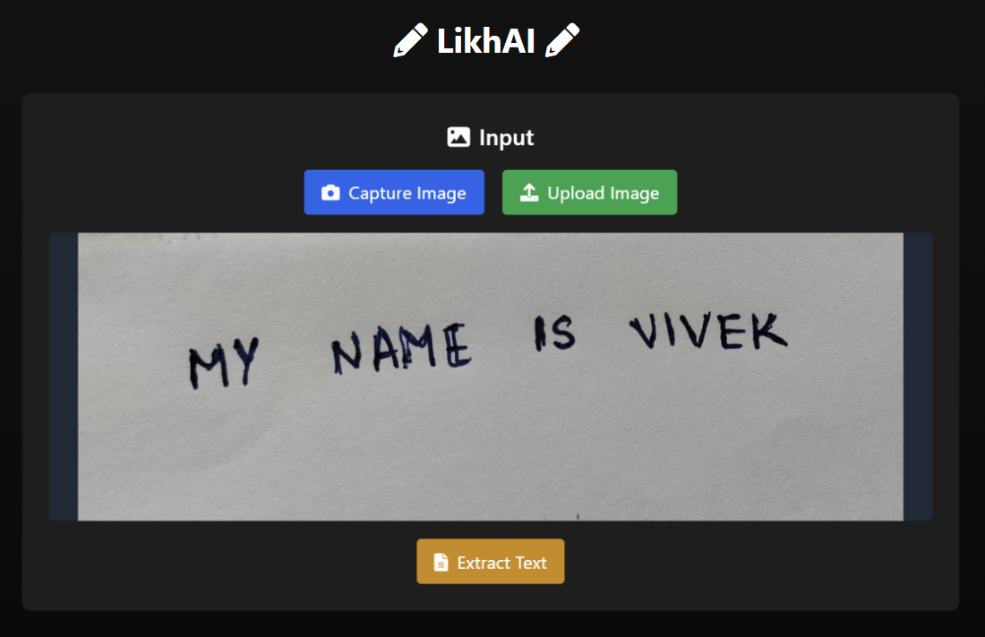
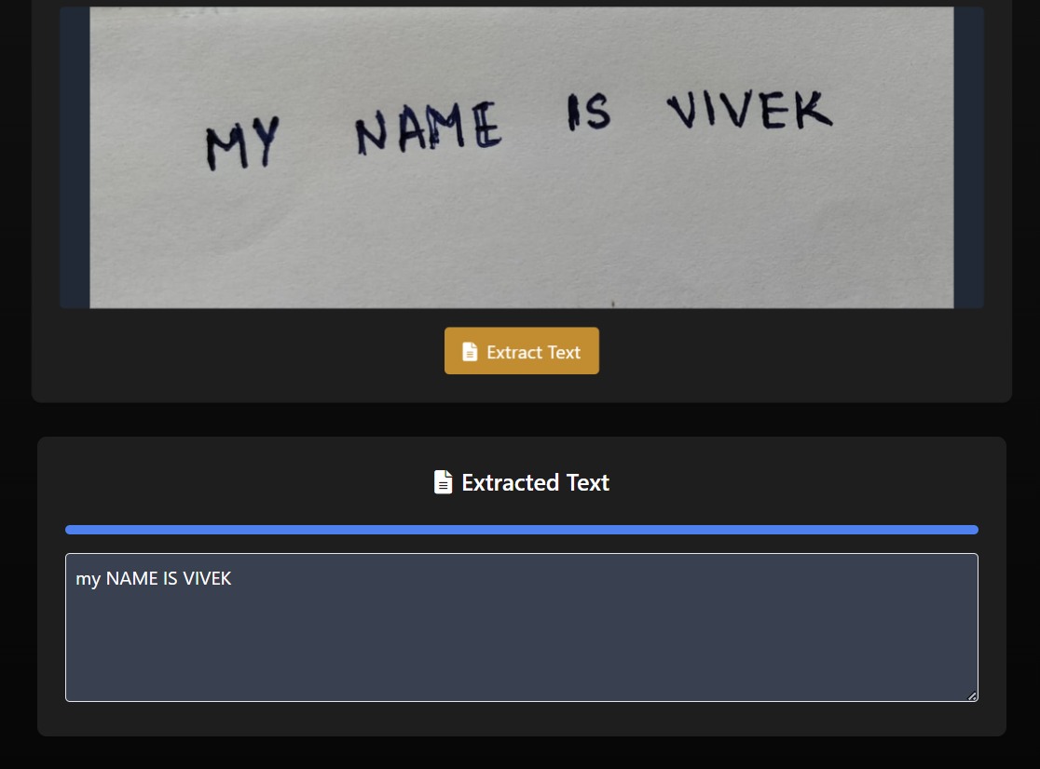
Results
Extracted using OCR

Slide 11
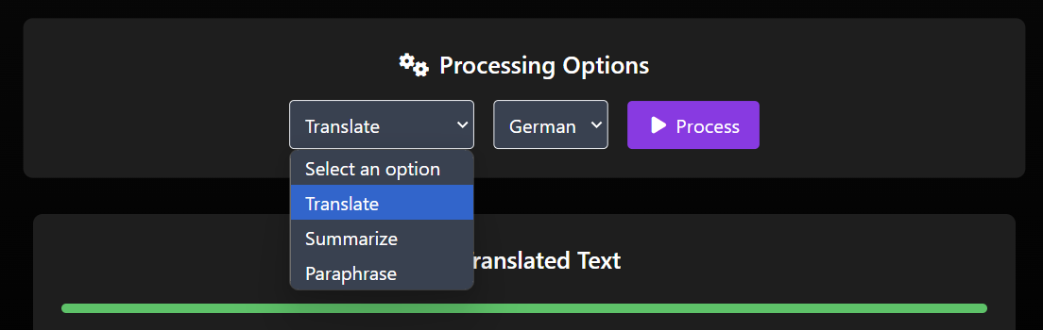
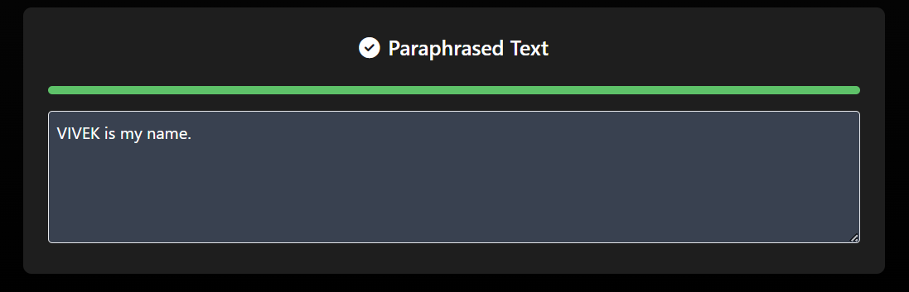
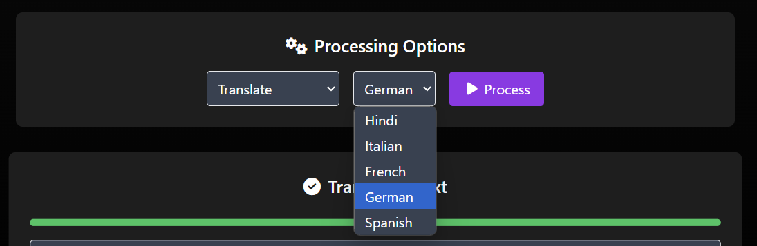
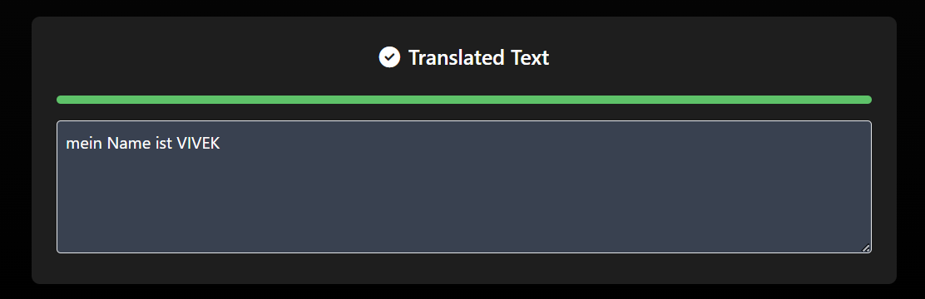
Results

Slide 12
References
https://www.researchgate.net/publication/315053242_Handwritten_Character_Recognition_in_English_A_Survey
https://cloud.google.com/translate/docs
https://huggingface.co/docs/transformers/en/index
https://www.researchgate.net/publication/13853244_Long_Short-term_Memory
https://www.researchgate.net/publication/285164623_An_Introduction_to_Convolutional_Neural_Networks
https://www.researchgate.net/publication/327814052_CTC_Loss_Function_with_a_Unit-Level_Ambiguity_Penalty

